Slide 1
NEXT STOP PREDICTION USING AI AND DATA MINING
Name: Thasreefa P M
Roll No:57
Product Owner: NOWSHAD C V

Slide 2
TABLE OF CONTENTS
Introduction
Modules
Algorithm Used
Methodology
Developing Environment
Data Flow Diagram
Table Design
Future Enhancements
User story
Project plan
Product Backlog
Sprint Backlog
Sprint Backlog Actual

Slide 3
NEXT STOP PREDICTION USING AI AND DATA MINING
Providing accurate information on bus arrival and departure times at bus stops is one of the key parameters of high-quality public transport today.
This project proposes a model for the real-time prediction of arrival times at bus stops.
The proposed model is based on information about the current location of the bus, the classification of runs into time periods with respect to the historical data, and the data model of the bus network.
Prediction is done by using Recurrent Neural Network(RNN)
Notifications and emergency messages can be viewed as voice.
Advertisements curresponding to the locations can be viewed.

Slide 4
MODULES
MODULE 1:- ADMIN
Login
Stop Management
Advertisement Management
Location Tracing
Emergency Photo Management
Public Notification Management
MODULE 2:- USER
Registration
Login
GPS Based Location Updation
Next Stop Announcement
Advertising Rendering Based on Georeference
Public Notification Announcement
Map Rendering
Emergency Message Announcement

Slide 5
Algorithm used
RECURRENT NEURAL NETWORK(RNN)
Recurrent neural network are a type of neural network where the output from previous steps are fed as input to the current step. An RNN remembers each and every information through time. Because of their internal memory, RNN’s can remember important things about the input they received, which allows them to be very precise in predicting what’s coming next. This is why they're the preferred algorithm for sequential data like time series, speech, text, financial data, audio, video, weather and much more. Recurrent neural networks can form a much deeper understanding of a sequence and its context compared to other algorithms.

Slide 6
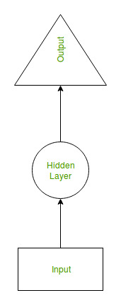
The main and most important feature of RNN is Hidden state, which remembers some information about a sequence. It uses the same parameters for each input as it performs the same task on all the inputs or hidden layers to produce the output. This reduces the complexity of parameters, unlike other neural networks.

Slide 7
METHODOLOGY
The most of the time wasted by the people is on waiting for buses on the bus stops which is really horrible. Thus it becomes essential to track the buses real location using GPS and provide passengers predicted time of bus arriving at the bus stop.
Prediction is done by using Recurrent Neural Network model.
Input : Select bus Output: Next time
Get stop of bus from database.
Get previous bus stops in the bus route in correct order.
Travel in each date , Travel in each stop , Create a vector with arriving time of bus in stop order.
Generate a vector of next stop arrival from database.
Create a time series from collected data.
Training , Testing
Gives predicted time as next stop arrival

Slide 8
DEVELOPING ENVIRONMENT
Hardware Requirements
Input Device : Mouse, Keyboard
Output Device : Monitor
Memory : 4 Gb Ram (Minimum)
Processor : Intel core i3 or above
Software Requirements
Operating System : Windows 8 /10for Better Performance
Front End : Python (Flask)
Back End : MySQL , Python (Flask)
Software Used : PyCharm , SQLyog , Dream Viewer
Web Browser :Internet Explorer/Google Chrome/Firefox(for web
application)

Slide 9
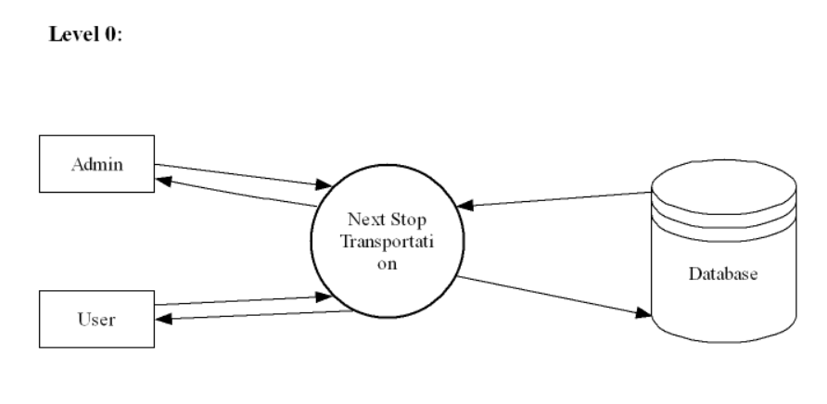
DATA FLOW DIAGRAM

Slide 10
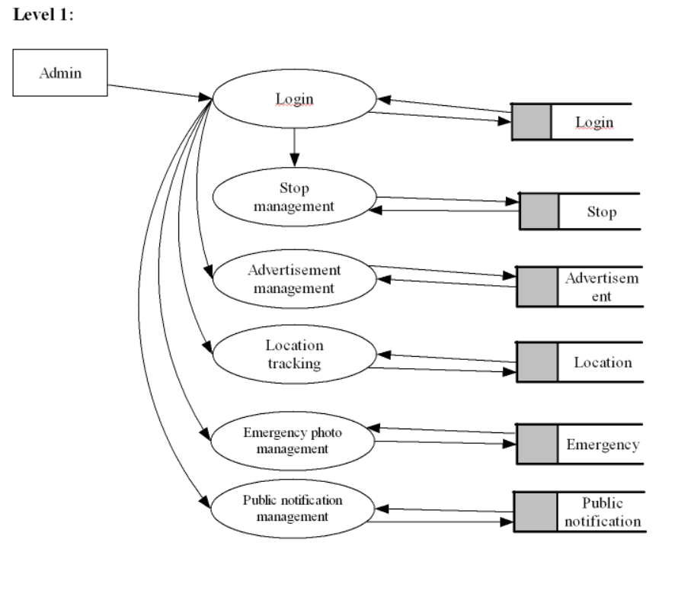

Slide 11
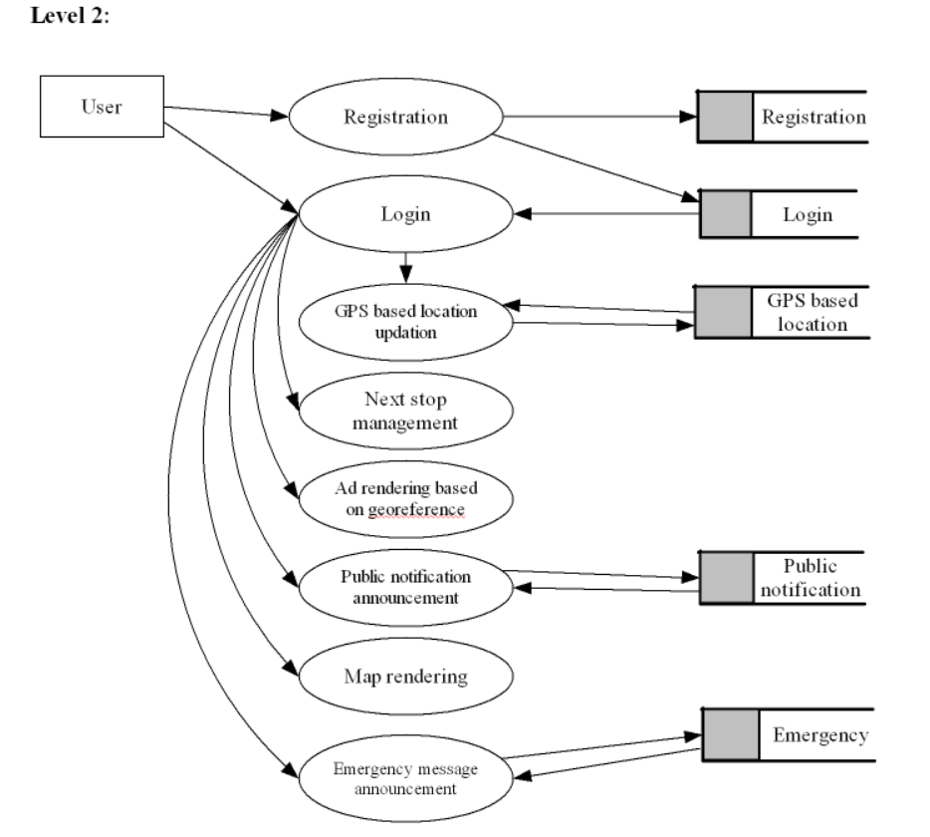

Slide 12
TABLE DESIGN
1. Login:
Field Name | Datatype | Constraints
Lid | Int | Primary Key
Username | Varchar (50) | Not Null
Password | Varchar (50) | Not Null
type | Varchar (50) | Not Null
2. Advertisement:
Field Name | Datatype | Constraints
advertisement id | Int | Primary Key
Photo | Varchar (50) | Not Null
date | date | Not Null
Latitude | Varchar (50) | Not Null
Longitude | Varchar(50) | Not Null

Slide 13
3. Bus:
Field Name | Datatype | Constraints
Busid | Int | Primary Key
busname | varchar (50) | Not Null
regno | varchar (50) | Not Null
color | Varchar (70) | Not Null
model | Varchar (50) | Not Null
photo | Varchar (50) | Not Null
routeid | int | Not Null
4. Emergency:
Field Name | Datatype | Constraints
Emergency id | Int | Primary Key
User id | int | Not Null
date | date | Not Null
time | time | Not Null
latitude | Varchar (50) | Not Null
longitude | Varchar (50) | Not Null

Slide 14
5. Location:
Field Name | Datatype | Constraints
location id | Int | Primary Key
latitude | varchar (50) | Not Null
longitude | varchar (50) | Not Null
Bus id | Int | Not Null
status | Varchar (50) | Not Null
date | date | Not Null
time | time | Not Null
6. Notification:
Field Name | Datatype | Constraints
notid | int | Primary key
notification | Varchar (50) | Not Null
date | date | Not Null

Slide 15
7. Route:
Field Name | Datatype | Constraints
routedid | int | Primary key
routename | Varchar (50) | Not Null
8. Stop:
Field Name | Datatype | Constraints
Stopid | Int | Primary Key
Routedid | int | Not Null
stopname | varchar (50) | Not Null
latitude | Varchar (50) | Not Null
longitude | Varchar (50) | Not Null
place | Varchar (50) | Not Null

Slide 16
9. User:
Field Name | Datatype | Constraints
User id | Int | Primary Key
name | Varchar (50) | Not Null
photo | varchar (50) | Not Null
place | Varchar (50) | Not Null
post | Varchar (50) | Not Null
pin | Int | Not Null
district | Varchar (50) | Not Null
email | varchar | Not Null
contact | bigint | Not Null
lid | int | Not Null

Slide 17
Future Enhancements
Traveller prioritized seats can be booked.
Implementing as a display system in all the bus stops ,so that the travelers can easily understand the arrival of buses.
Bus entry using RFID cards
Missing person detection using bus camera syste

Slide 18
USER STORY
User Story ID11 | As a type of User | I want to < perform some task > | So that I can < Achieve Some Goal >
1 | Admin | Login | Admin can login to the application
2 | Admin | Add route | Admin can add route
3 | Admin | View route | Can view the add route details
4 | Admin | Editing route | After viewing , admin can edit route details
5 | Admin | Delete route | Admin can delete the added route details
6 | Admin | Add stop | Admin can add stop details
7 | Admin | Edit stop | Added stop details will be edited by admin
8 | Admin | Delete stop | Admin can delete the added stop details
9 | Admin | Add bus | Admin can add bus details
10 | Admin | View bus | Can view the add bus details
11 | Admin | Edit bus | Admin can edit bus details

Slide 19
12 | Admin | Delete bus | Admin can delete the bus details
13 | Admin | Add advertise | Admin can add advertise details
14 | Admin | Edit advertise | Admin can edit advertise details
15 | Admin | Delete advertise | Admin can delete advertise details
16 | Admin | Add public notification | Admin can add notification
17 | Admin | View notification | Admin Can view notification
18 | Admin | Edit notification | Admin Can edit notification
19 | Admin | Delete notification | Admin can delete notification
20 | Admin | Add emergency | Admin can add emergency photos
21 | Admin | View emergency | Admin can view emergency photos
22 | Admin | Edit emergency | Admin can edit emergency photos
23 | Admin | Delete emergency | Admin can delete emergency photos

Slide 20
24 | Admin | Location track | Admin can track location
25 | User | Registration | User can register for the application
26 | User | Login | User can login into the application, if once they register
27 | User | View profile | User can view their profile
28 | User | Update location | User can update their location
29 | User | View bus | User can view bus details
30 | User | Next stop prediction | User can predict next stop
31 | User | View emergency messages | User can view emergency messages
32 | User | View public notification | User can view public notification

Slide 21
PROJECT PLAN
User Story ID | Task Name | Start Date | End Date | Days | Status
1 | Sprint 1 | 26/12/2021 | 28/12/2021 | 2 | Completed
2 |  | 29/12/2021 | 31/12/2021 | 3 | Completed
3 |  | 03/01/2022 | 08/01/2022 | 5 | Completed
4 | Sprint 2 | 09/01/2022 | 16/01/2022 | 8 | Completed
5 |  | 18/01/2022 | 22/01/2022 | 5 | Completed
6 | Sprint 3 | 23/01/2022 | 27/01/2022 | 5 | Completed
7 |  | 30/01/2022 | 05/02/2022 | 7 | Completed
8 | Sprint 4 | 06/02/2022 | 10/01/2022 | 5 | Completed
9 |  | 16/02/2022 | 19/02/2022 | 4 | Completed

Slide 22
PRODUCT BACKLOG
User Story ID | Priority <High/Medium/Low> | Size (Hours) | Sprint <#> | Status <Planned/In progress/Completed> | Release Date | Release Goal
1 | Medium | 2 | 1 | Completed | 08/01/2022 | Table design
2 | High | 3 |  | Completed | 08/01/2022 | Form design
3 | High | 5 |  | Completed | 08/01/2022 | Basic coding
4 | High | 5 | 2 | Completed | 16/01/2022 | Creation data set
5 | Medium | 5 |  | Completed | 22/01/2022 | Coding
6 | High | 5 | 3 | Completed | 27/01/2022 | Training
7 | Medium | 5 |  | Completed | 05/02/2022 | Prediction
8 | Medium | 5 | 4 | Completed | 10/02/2022 | Testing data
9 | High | 5 |  | Completed | 19/02/2022 | Output generation

Slide 23
SPRINT BACKLOG
Backlog Item | Status & completion date | Original estimate in hours | Day1 | Day2 | Day3 | Day4 | Day5 | Day6 | Day7 | Day8 | Day9 | Day10 | Day11 | Day12 | Day13 | Day14
User story #1,#2,#3 |  | hrs | hrs | hrs | hrs | hrs | hrs | hrs | hrs | hrs | hrs | hrs | hrs | hrs | hrs | hrs
Table design | 28/12/2021 | 2 | 1 | 1 | 0 | 0 | 0 | 0 | 0 | 0 | 0 | 0 | 0 | 0 | 0 | 0
Form design | 31/12/2021 | 3 | 0 | 0 | 0 | 1 | 1 | 1 | 0 | 0 | 0 | 0 | 0 | 0 | 0 | 0
Coding | 08/01/2021 | 5 | 0 | 0 | 0 | 0 | 0 | 0 | 0 | 0 | 0 | 1 | 1 | 1 | 1 | 1
User story #4,#5
Creation dataset | 16/01/2022 | 5 | 1 | 1 | 0 | 1 | 0 | 1 | 0 | 1 | 0 | 0 | 0 | 0 | 0 | 0
Coding | 22/01/2022 | 5 | 0 | 0 | 0 | 0 | 0 | 0 | 0 | 0 | 0 | 1 | 1 | 1 | 1 | 1
User story #6,#7
Training | 27/01/2022 | 5 | 1 | 1 | 1 | 1 | 1 | 0 | 0 | 0 | 0 | 0 | 0 | 0 | 0 | 0
Prediction | 05/02/2022 | 5 | 0 | 0 | 0 | 0 | 0 | 0 | 0 | 1 | 0 | 1 | 1 | 1 | 0 | 1
User story #8,#9
Testing data | 10/02/2022 | 5 | 1 | 1 | 1 | 1 | 1 | 0 | 0 | 0 | 0 | 0 | 0 | 0 | 0 | 0
Output generation | 19/02/2022 | 5 | 0 | 0 | 0 | 0 | 0 | 0 | 0 | 0 | 0 | 2 | 1 | 1 | 1 | 1
Total |  | 40 | 4 | 4 | 2 | 4 | 3 | 2 | 0 | 2 | 0 | 5 | 4 | 4 | 3 | 4

Slide 24
SPRINT BACKLOG ACTUAL
Backlog Item | Status & completion date | Original estimate in hours | Day1 | Day2 | Day3 | Day4 | Day5 | Day6 | Day7 | Day8 | Day9 | Day10 | Day11 | Day12 | Day13 | Day14
User story #1,#2,#3 |  | hrs | hrs | hrs | hrs | hrs | hrs | hrs | hrs | hrs | hrs | hrs | hrs | hrs | hrs | hrs
Table design | 28/12/2021 | 2 | 1 | 1 | 0 | 0 | 0 | 0 | 0 | 0 | 0 | 0 | 0 | 0 | 0 | 0
Form design | 31/12/2021 | 3 | 0 | 0 | 0 | 1 | 1 | 1 | 0 | 0 | 0 | 0 | 0 | 0 | 0 | 0
Coding | 08/01/2021 | 5 | 0 | 0 | 0 | 0 | 0 | 0 | 0 | 0 | 0 | 1 | 1 | 1 | 1 | 1
User story #4,#5
Creation dataset | 16/01/2022 | 5 | 1 | 1 | 0 | 1 | 0 | 1 | 0 | 1 | 0 | 0 | 0 | 0 | 0 | 0
Coding | 22/01/2022 | 5 | 0 | 0 | 0 | 0 | 0 | 0 | 0 | 0 | 0 | 1 | 1 | 1 | 1 | 1
User story #6,#7
Training | 27/01/2022 | 5 | 1 | 1 | 1 | 1 | 1 | 0 | 0 | 0 | 0 | 0 | 0 | 0 | 0 | 0
Prediction | 05/02/2022 | 5 | 0 | 0 | 0 | 0 | 0 | 0 | 0 | 1 | 0 | 1 | 1 | 1 | 0 | 1
User story #8,#9
Testing data | 10/02/2022 | 5 | 1 | 1 | 1 | 1 | 1 | 0 | 0 | 0 | 0 | 0 | 0 | 0 | 0 | 0
Output generation | 19/02/2022 | 5 | 0 | 0 | 0 | 0 | 0 | 0 | 0 | 0 | 0 | 2 | 1 | 1 | 1 | 1
Total |  | 40 | 4 | 4 | 2 | 4 | 3 | 2 | 0 | 2 | 0 | 5 | 4 | 4 | 3 | 4

Slide 25
THANK YOU

